Slide 1
Response to Irish Rail Submission on Observations to the Draft Railway Order Application
John Devitt, Stationcourt View, Coolmine, Dublin 15

Slide 2
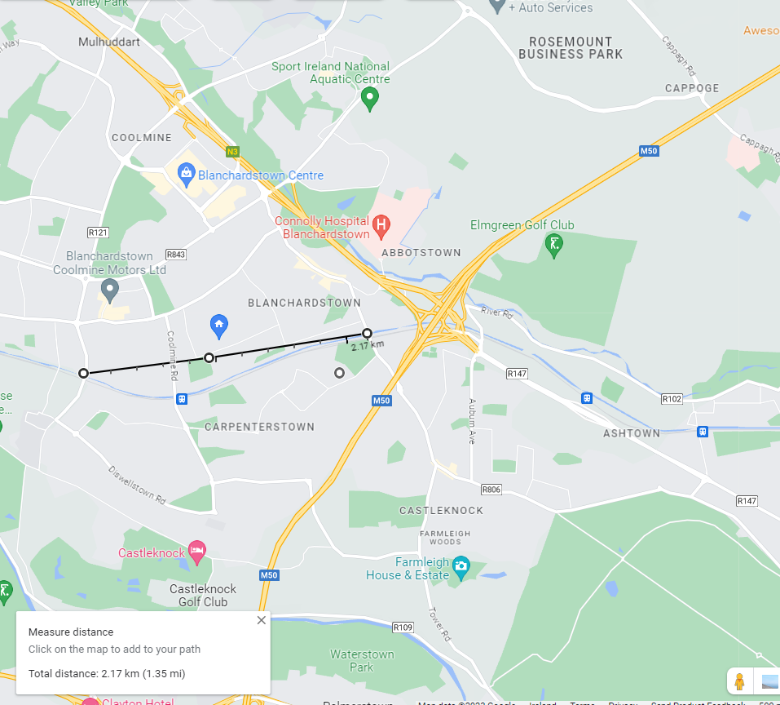

Slide 4
Irish Rail Summary of Submission: 4.37 Ref. No.38 – Env41 (page 177)
Requests that capacity assessment be undertaken by Irish Rail on the Maynooth line after the electrification of the line before a final decision on the future of the level crossing at Coolmine.
Requests Irish Rail engage in meaningful public consultation and public information efforts with affected communities during the capacity assessment.
Improve signalling to reduce waiting times at Coolmine level crossing.
In collaboration with Fingal County Council, introduce appropriate safety measures along Coolmine and Carpenterstown Road and the approach to the level crossing.
States that closing level crossing in Coolmine will increase journey time for emergency services.
States that closing level crossing in Coolmine will cause community disconnection between areas either side of track.
States that closing level crossing in Coolmine will increase traffic congestion.
States that increased traffic congestion will lead to more air pollution.

Slide 5
Coolmine Level Crossing, 5 October 2021 at 9.42am , 21:27

Slide 6
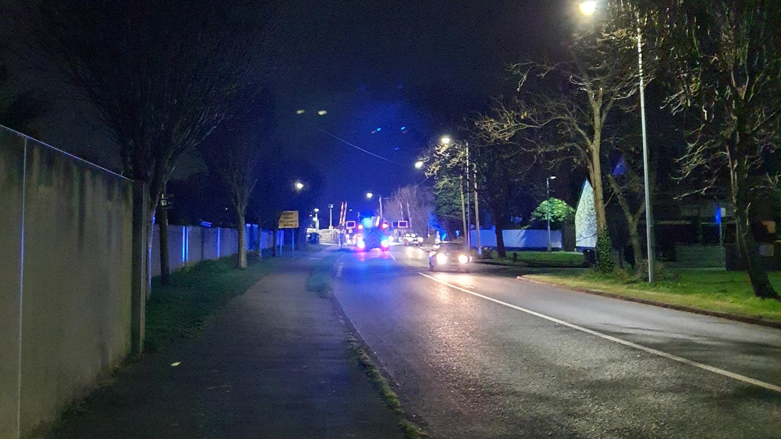
Coolmine Level Crossing, 27 March 2023, 21:27

Slide 7
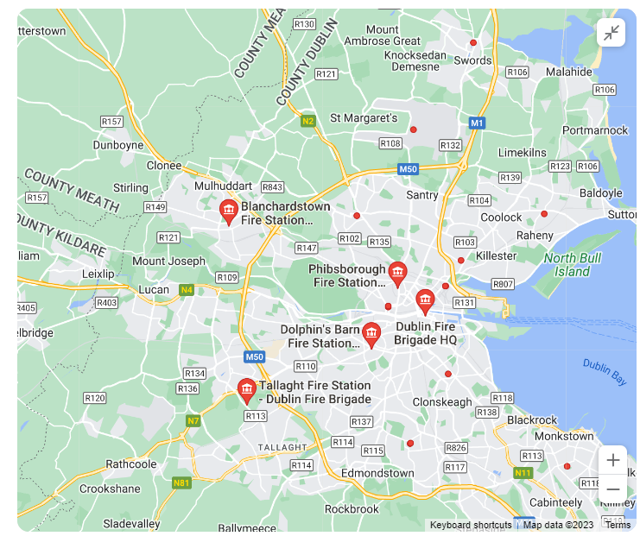

Slide 9
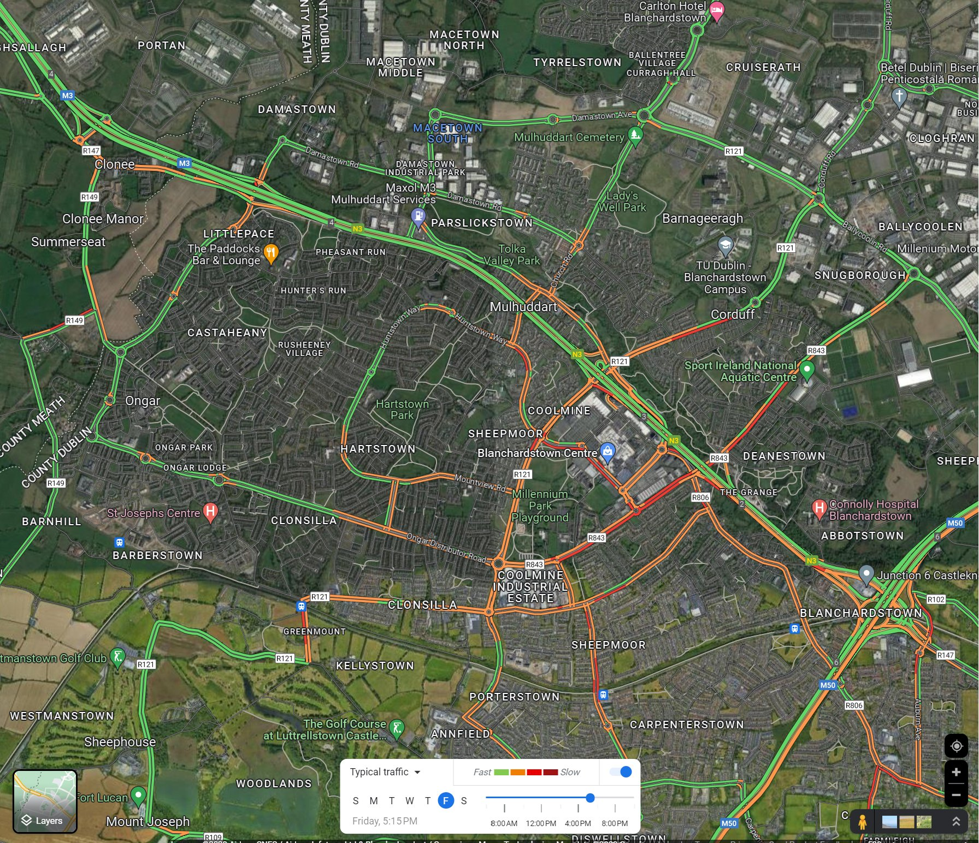

Slide 10
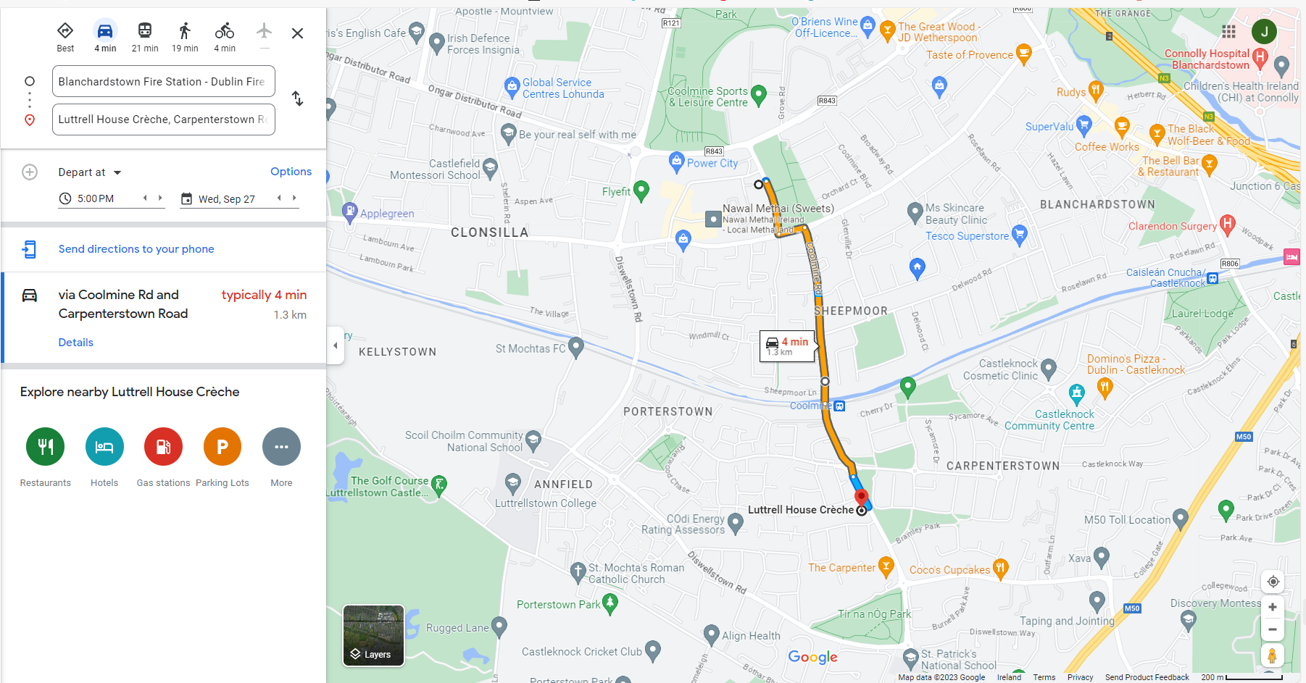

Slide 11
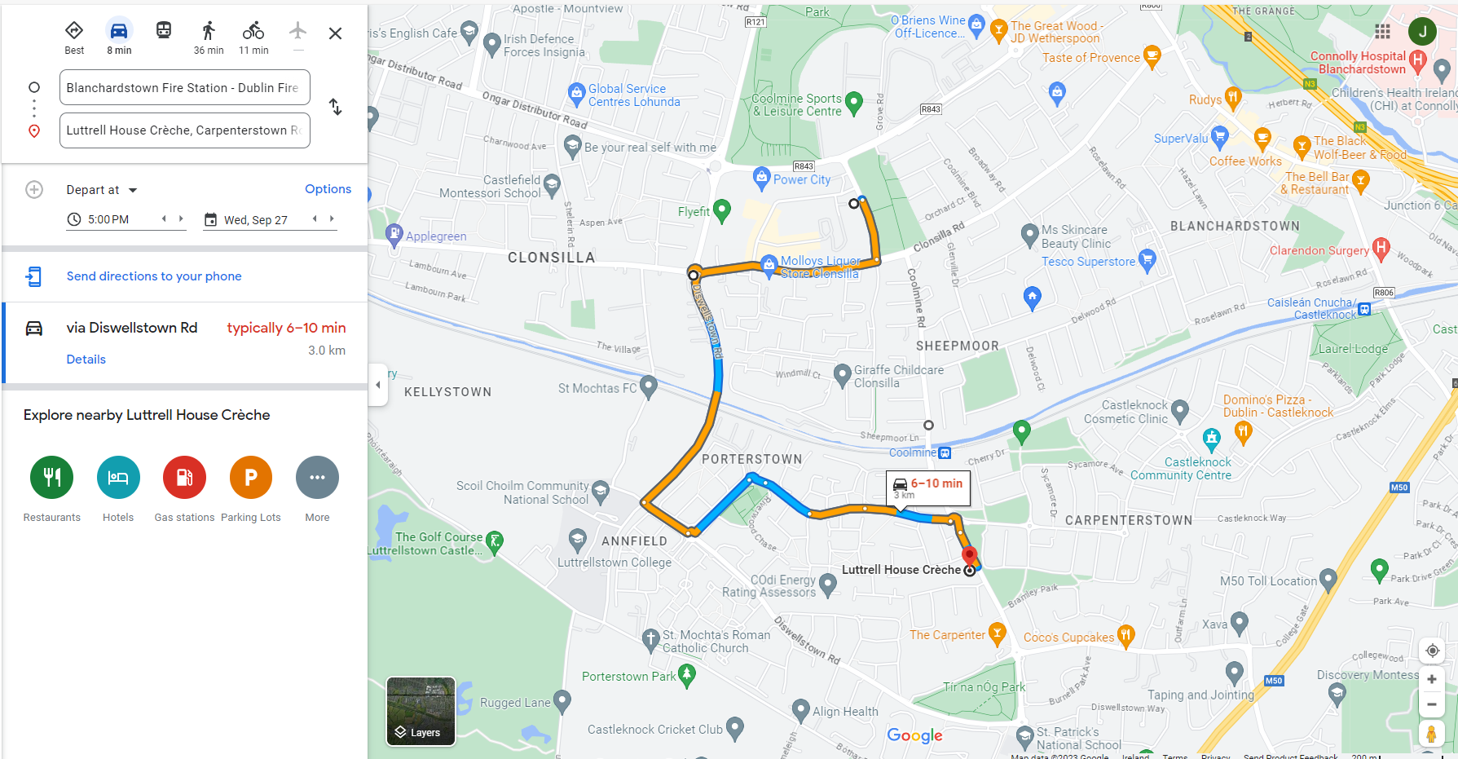

Slide 12
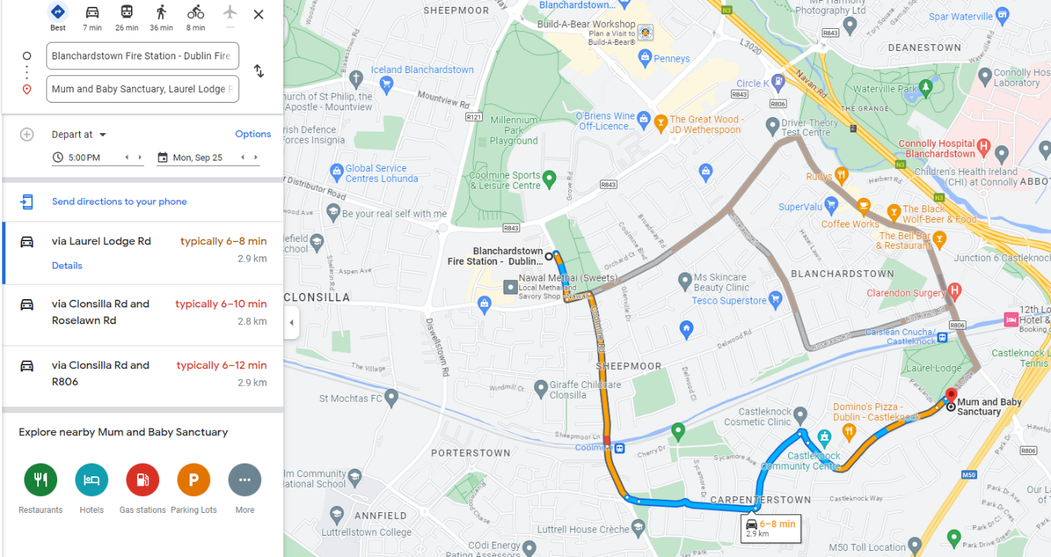

Slide 13
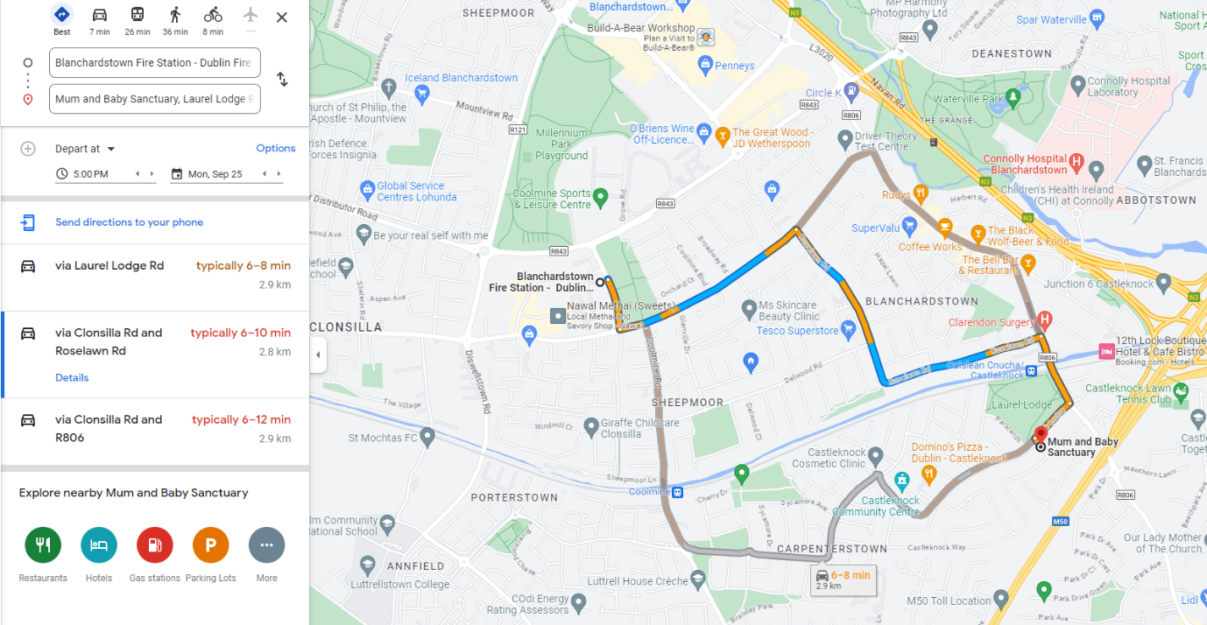

Slide 14
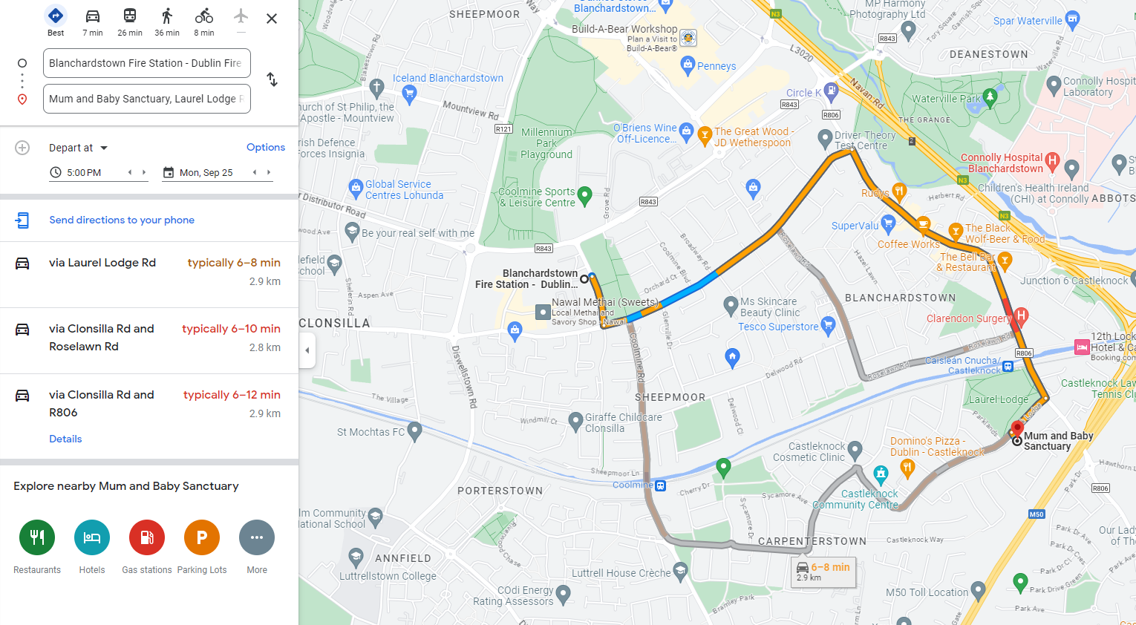

Slide 15
Closures

Slide 16
Capacity Assessments

Slide 17
Thank You

